Slide 1
EXOPLANET HABITABILITY PREDICTION
USING MACHINE LEARNING
Name : rushitha konangi
Branch : ece

Slide 2
PROJECT OVERVIEW
Predict exoplanet habitability using ML
Uses planetary and stellar data
Binary and multi-class classification
PROBLEM STATEMENT
No direct habitability label
Missing values and outliers
Highly imbalanced dataset

Slide 3
DATASET USED
NASA Exoplanet Archive (Kaggle)
Planet radius, mass, temperature
Orbital distance and star properties
DATA PREPROCESSING
Removed irrelevant columns
Handled missing values
Outlier detection and cleaning

Slide 4
EXPLORATORY DATA ANALYSIS
Histogram and boxplots
Scatter plots
Correlation heatmaps
FEATURE ENGINEERING
Habitability score index
Stellar compatibility index
Scaling and PCA

Slide 5
CLASS IMBALANCE HANDLING
Habitable planets are rare
Applied SMOTE
Stratified 80:20 split
ML MODELS USED
Logistic Regression
Support Vector Machine
Random Forest
XGBoost

Slide 6
MODEL EVALUATION
Accuracy, Precision, Recall
F1-Score and ROC-AUC
Confusion Matrix

Slide 7
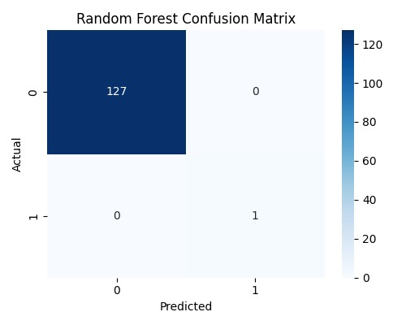
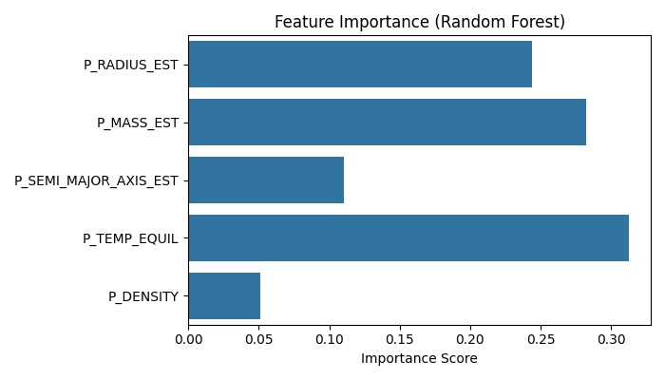
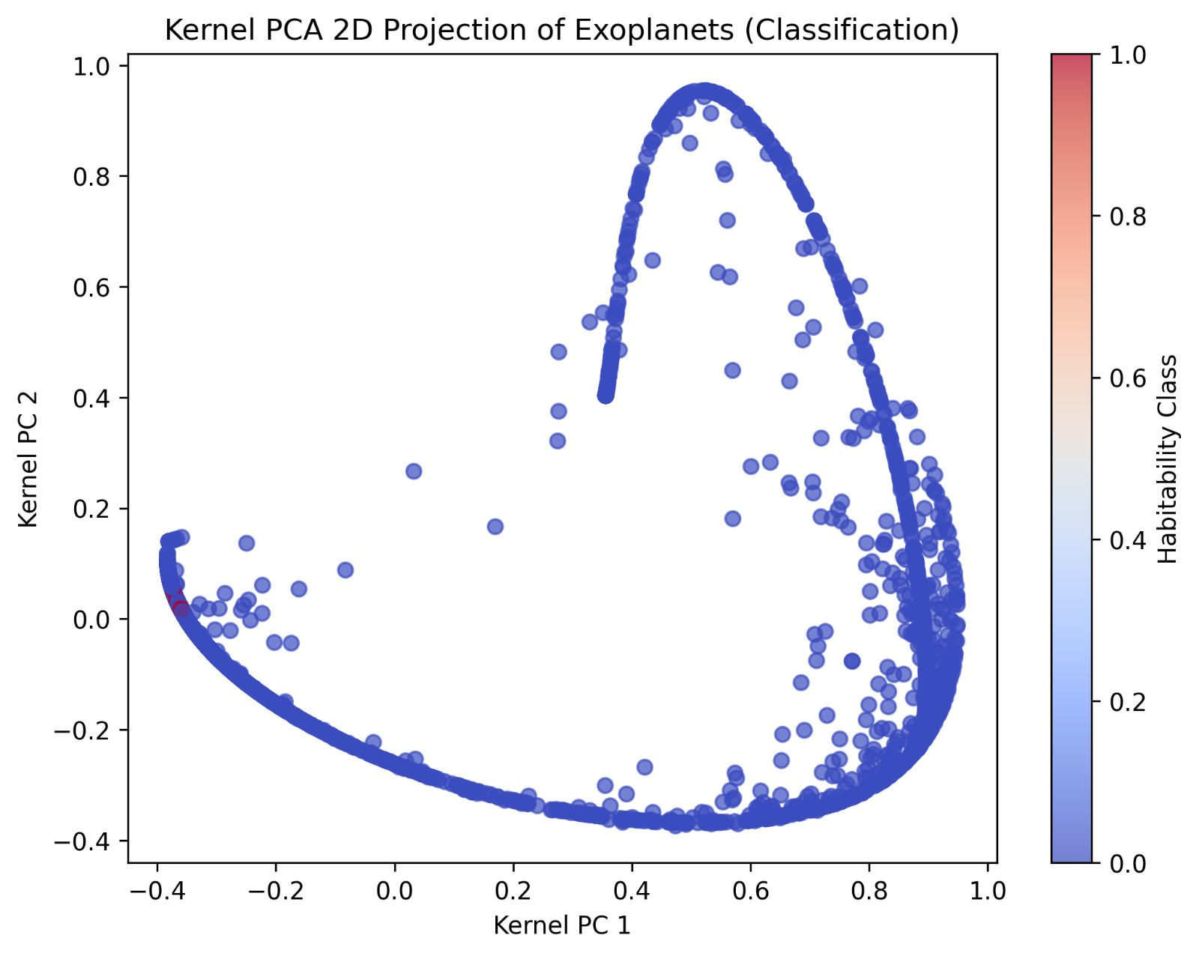
RESULTS
Random Forest performed best
Important features identified
Top exoplanets ranked

Slide 8
DEPLOYMENT & DASHBOARD
FastAPI REST backend
Render cloud deployment
Interactive dashboard

Slide 9
FUTURE SCOPE
Deep learning models
Real-time NASA data
Advanced visualization

Slide 10
Video Demo:
https://onedrive.live.com/?qt=allmyphotos&photosData=%2Fshare%2F7455FACDCC191830%21s7ba3f36466c141838e8686b421bd15d1%3Fithint%3Dvideo%26e%3DGx7JbM%26migratedtospo%3Dtrue&cid=7455FACDCC191830&id=7455FACDCC191830%21s7ba3f36466c141838e8686b421bd15d1&redeem=aHR0cHM6Ly8xZHJ2Lm1zL3YvYy83NDU1ZmFjZGNjMTkxODMwL0lRQms4Nk43d1dhRFFZNkdoclFodlJYUkFaUUhGSDJZb3ItSVAxand4RzQzQ1dnP2U9R3g3SmJN&v=photos
Live Application URL:
https://habitability-of-exoplanets-2.onrender.com/
GitHub Repository:
https://github.com/springboardmentor74280b-design/Habitability-of-Exoplanets/tree/rushitha-konangi

Slide 11
Questions & Answers

Slide 12
THANK YOU !

